Slide 1
MONTHLY REPORT
OKTOBER 2026
MOCHAMAD ANNAS KHADAFI
SYSTEM & DIGITAL SOLUTION

Slide 2
KPI SYSTEM DIGITAL SOLUTION
No | Perspective | Strategic Objective | KPI/Measurement | Target | Q1 | Q2 | Q3 | Q4 | Remark
1 | Customer | Financial Impact of Improvement Project | Advanced Business Intelligence & Data Governance | 100% | 100% |  |  |  | All Dashboard Revenue, Stock, Marketing, & Analysis on One Chitra
2 | Customer | EES Index | Unified Digital Hub (One-Page Integrated Portal) | 100% | 100% |  |  |  | Integrasi With One Chitra
3 | Customer | Inventory Turn Over | One Chitra" Ecosystem & IoT Integration | 100% | 95% |  | 100% |  | rfid WEB DONE, Waiting Collaboration RFID Reader on Camos
4 | Financial | Financial Impact of Improvement Project | Agile System Development & Digital Optimization | 2 System | 60% | 80% | 100% |  | HERO SYSTEM -HC System - Repair System - Service System - Aset management System
5 | Learning & Growth | Establish Condusive Working Environment | EES Index | 90% |  |  |  |  | End Year

Slide 3
KPI SYSTEM DIGITAL SOLUTION
KPI update
Monthly Activity
What we did
Evidence
Update Progress overall work program or SI (Strategic Initiative) by gantt chart
What on progress / planning on next months / Highlight Issue
Obstacle or need support
Appendix (If need)

Slide 4
What We Have Done / List ( Evidance )
HERO ECOSYSTEM
• HSE On the Spot Monitoring (OSM v2) Mobile & Desktop Multi-Findings + SLA Email
• Job Safety Analysis (JSA) Single-Page A4 Engineering Standard & Official Stationery
• Timesheet & SPL Overtime Roster Payroll Engine (Roster 6:1, Night Shift +1 Reconciliation)
• General Affairs (GA Vehicles & Reminder, House Rental, & P7 ATK Management)
• HC Disciplinary Desk & Flight Route Change 5-Tier Approval Matrix
• Form Studio Customer Survey Analytics & Multi-Column Dynamic Excel Export
ONE-CHITRA ECOSYSTEM
• RMI & Tire Price Adjustment Simulator Formula Synchronization with Excel Report
• Customer Legal Documents Hub (62 Docs S3 Cloud Storage & PDF Inspector Modal)
• RFID & Gate Logistics Vehicle Integration (Ekspedisi, Plat Truk, Tujuan, Driver)
• Delivery Order (DO) Monitoring Multi-Key S3 & Inline PDF Preview Inspection
• Competitor Dashboard Tire Repair Price Isolation & Slow Moving Optimization
• S3 Object Storage Security Hardening & BI Database Pool Safeguards

Slide 5
Update Progress overall work program or SI (Strategic Initiative) - Oktober 2026
(Strategic Initiative) by gantt chart

Slide 6
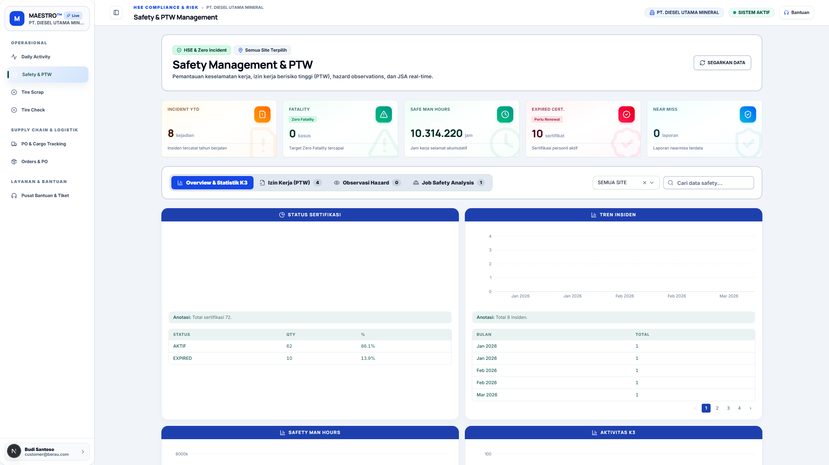
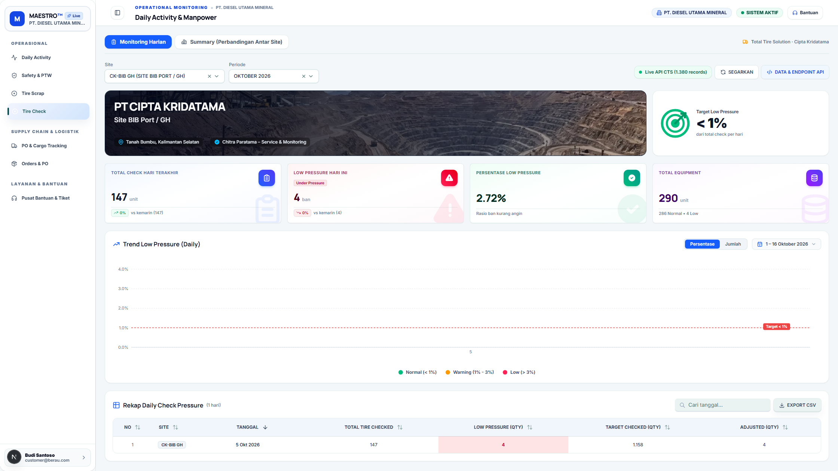
HERO Update
On-site occupational safety and health (K3) inspection with multiple findings (SLA email to PIC) and standardization of PT Chitra Paratama’s official JSA documents
HSE On the Spot Monitoring (OSM v2) & JSA A4 Standard

Slide 7
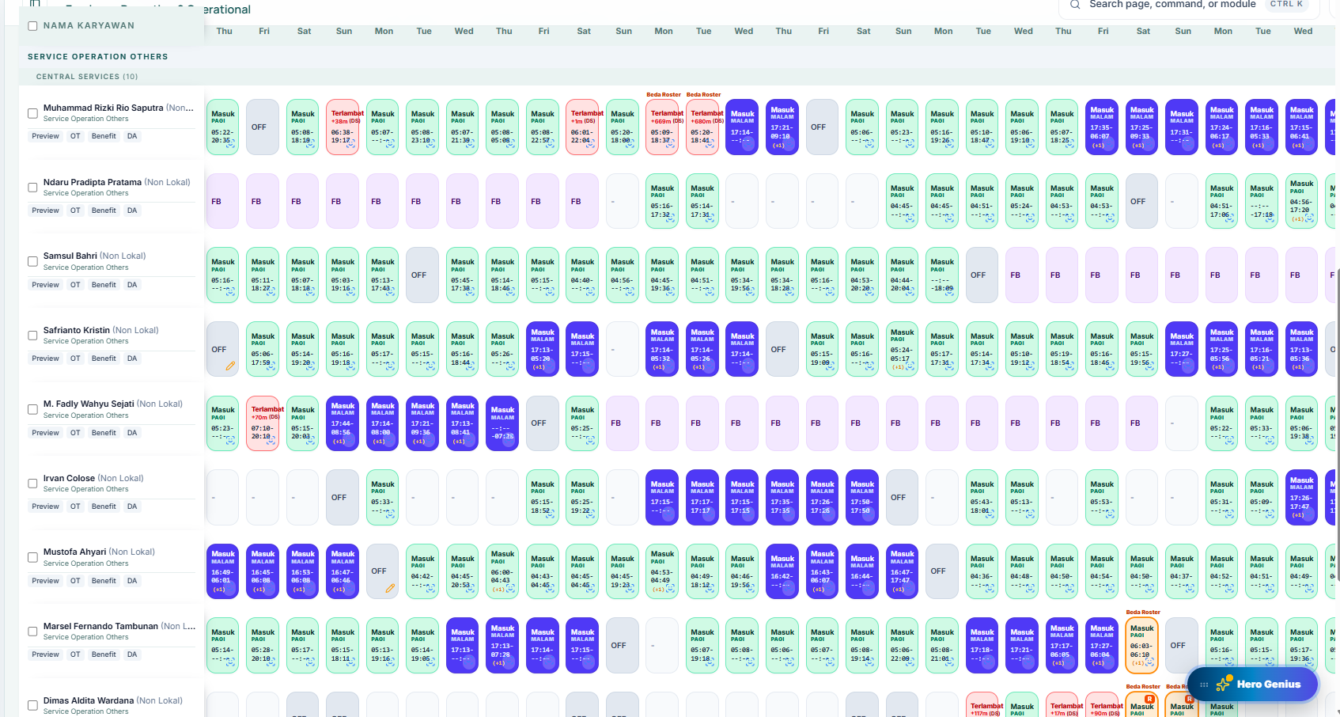
HERO Update
Reconciliation of checkout transactions across night shifts (+1) and automation of SPL overtime hours based on payroll work rosters

Slide 8
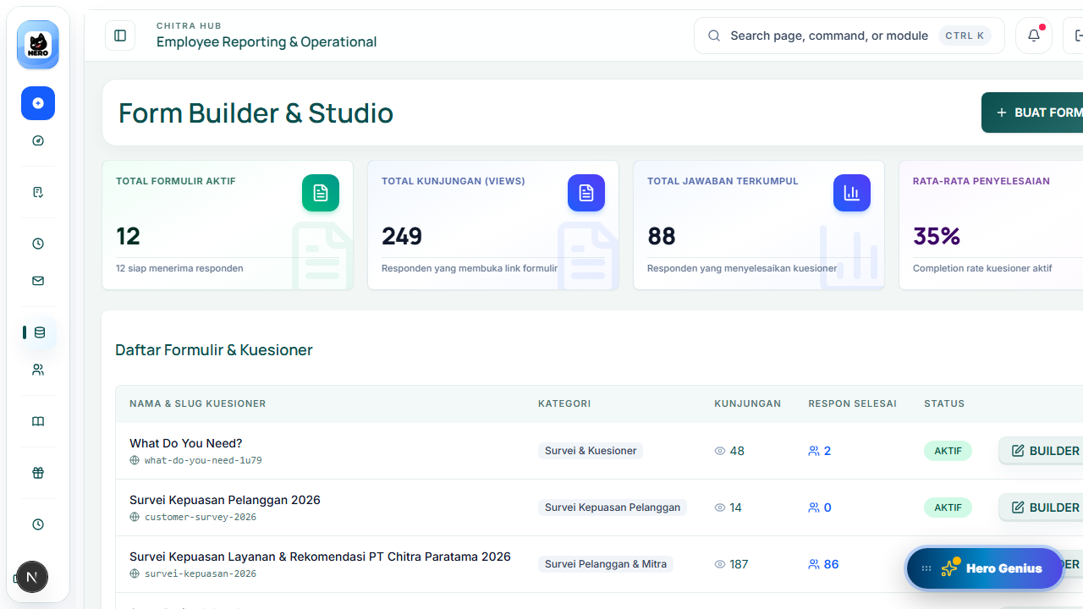
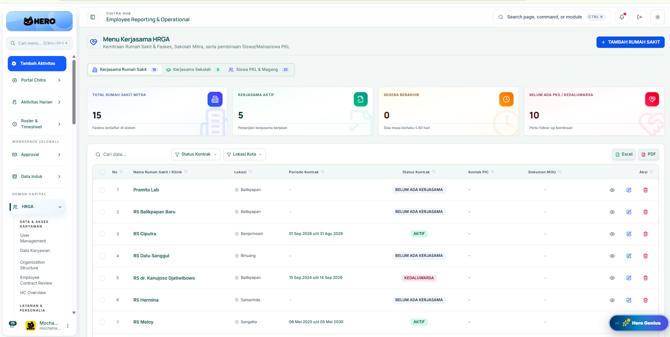
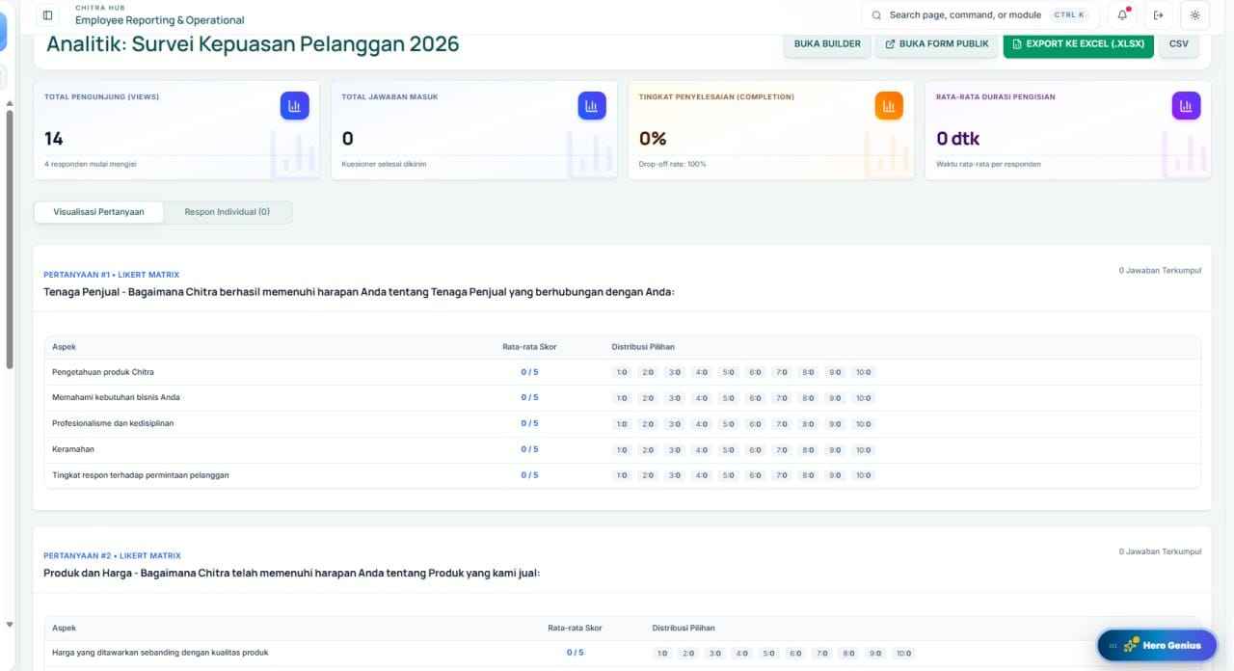
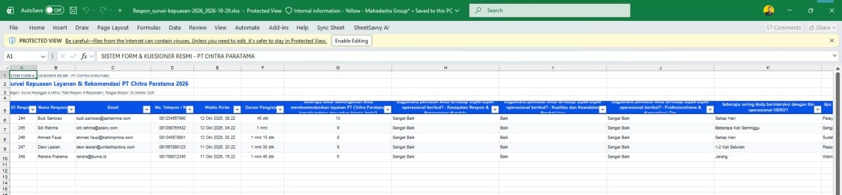
Form Studio Customer Survey &
General Affairs Management
HERO Update

Slide 9
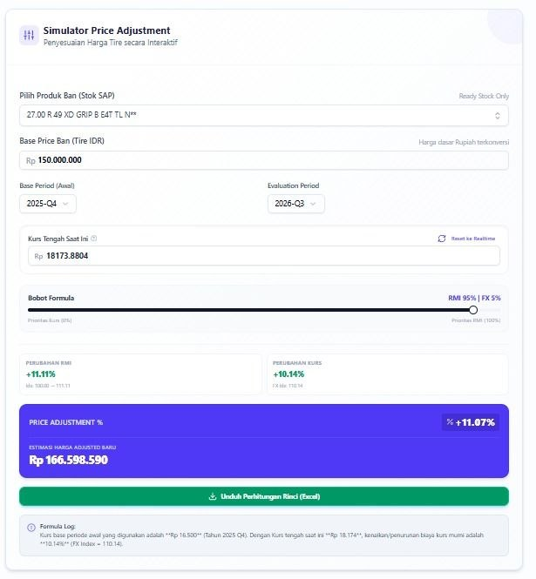
ONE-CHITRA Update
RMI & Tire Price Adjustment Simulator
(Excel Report Synchronization)

Slide 10
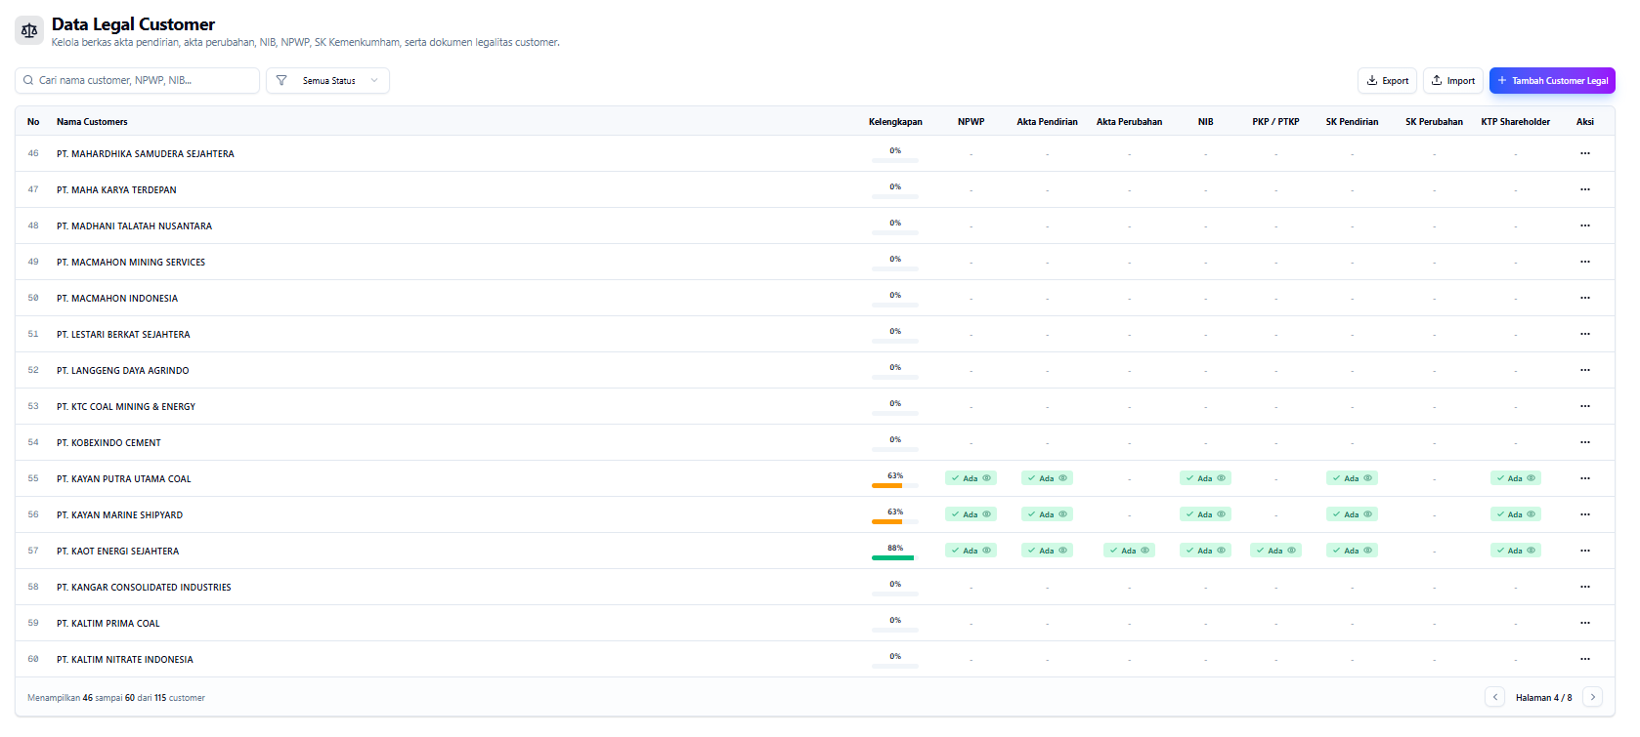
ONE-CHITRA Update
Customer Legal Documents Hub & S3 Private Storage

Slide 11
Planning on next months
• HERO: Improvements to the AI Vision Road Condition & Pothole Assessment system and full integration of the online Safety Induction program.

Slide 12
Obstacle or need support
NOTHING / ALL ON TRACK
• Cross-departmental coordination (HSE, HRGA, Supply Chain, IT Operations) is proceeding smoothly.
• All October sprint targets and feature deployments were successfully completed on time on the production server.

